Slide 1

Python Level 2
Lesson 5: Off to the Movies

Slide 2
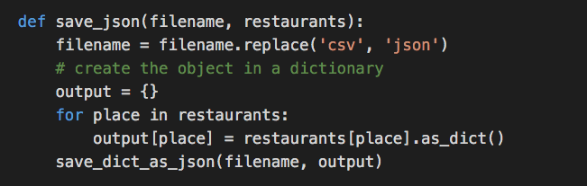

Last time
We’ve switched our restaurants review program to read and store our data as JSON
But there’s a (potential) problem with JSON. What is it?

Slide 3
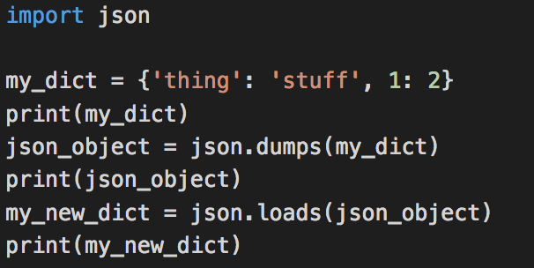
Beware!
What you put into JSON might not be the same when it comes back:

Slide 4
Building blocks

Slide 5
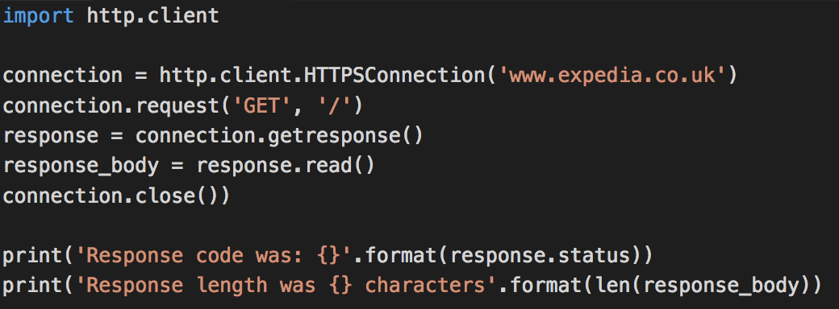
And now for something completely different

Slide 6
And now for something completely different
The equivalent in Python of typing https://www.expedia.co.uk/ into your browser.

Slide 7
HTTP: HyperText Transmission Protocol
Too complicated to cover the entire protocol
Google RFC2616 if you’re bored or need some bedtime reading
In short, we send:
a verb (usually GET, PUT, POST or DELETE)
A path ( ’/’ is the root (top level) path – you’ve seen these in URLs)
Some other stuff we don’t need to care about right now
We get back:
A response code (‘200’ means ’OK’)
Some content (usually)

Slide 8
When RESTing is desirable
REST: Representational State Transfer
A way for computer programs to use HTTP to manipulate data
JSON is frequently used to encode the data
REST powers a bunch of tools used internally:
Trello
Jira
Mingle
Etc, etc
But they’re boring. Let’s look at something a bit flashier.

Slide 9
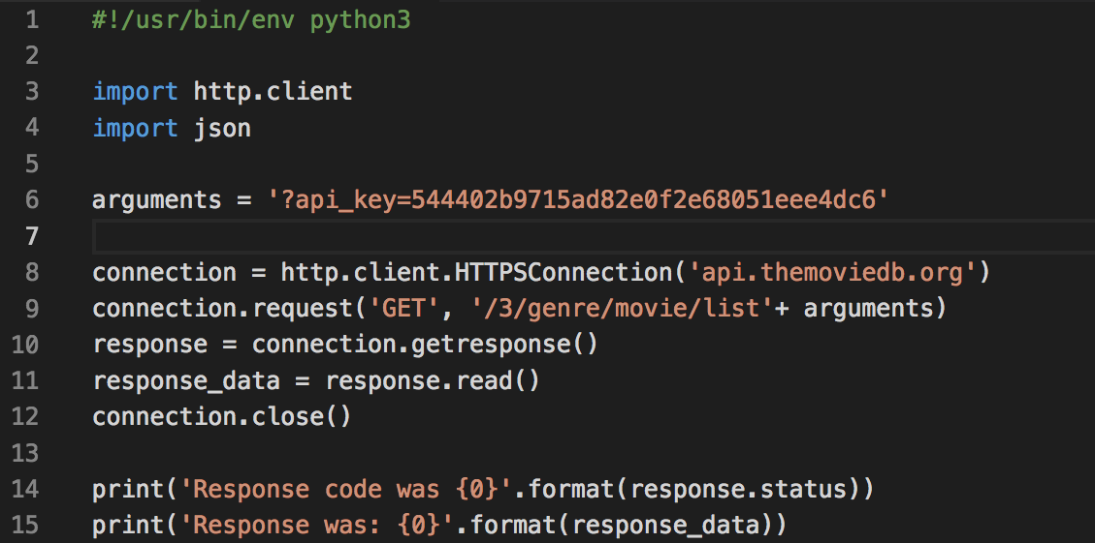
Genre-defying code

Slide 10
Exercise
Fetch the list of genres from The Movie DB
Display them for the user, one per line
Hints:
You must always supply an API key (if you’re able to, get your own)
Done that?
Get a list of movies belonging to a (user-specified) genre. GET request for /3/genre/<genre id>/movies will give data about movies belonging to that genre id

